Slide 1
CMPE 220
Class 8 – Compilers (part 1)
Notes:
Let’s talk about history.
California State Railroad Museum – 1976 - docents worked on original steam engines.

Slide 2
Building Software
High Level Language Source Code (e.g. C++)
Assembly Language Source Code
Object file (binary machine code and tables)
Compiler
Assembler
optional
Executable
file
In-Memory
Code
Linker
Loader
Hardware Execution

Slide 3
High Level Languages
Compilers convert “high level languages” to assembly language
The original goals of high level languages were two-fold:
Make it easier to write and to read programs
Write portable programs that could run on any hardware
This latter goal meant that the language had to be independent of the machine architecture… it had to provide a level of abstraction that hid the details of registers, opcodes, and even memory architecture.
Computers had to have memory and processing speed to spare!
Early languages had very rigid formats and few “features” – but languages evolved, experimenting with new ways of programming (and making the task of writing compilers progressively harder).

Slide 4
21 Important Programming Languages
My list – others may differ
The purpose of reviewing these languages is to:
get a sense of how languages evolved and continue to evolve
understand some of the key features of programming languages today, and how they affect compilers and code generation
As we go through the list, keep track of:
How many of these languages you have heard of
How many of these languages you have used

Slide 5
A Few Important Languages – the Early Years
A (or A-0) – 1952 – created by Grace Hopper, and often considered the first high-level language
FORTRAN (FORmula TRANslation) - 1957 – developed at IBM - focus on math and science programming
LISP (LISt Processor) – 1958 – built in support for “list” data structures – emphasis on mathematical programming
ALGOL (ALGOrithmic Language) – 1958 – in many ways, ahead of its time – a very “structured” language, used in teaching for decades
RPG (Report Program Generator) – 1959 – a non-procedural language that allowed users to describe/specify the desired output, and how it was produced.
Notes:
People are allergic to change, you have to get out and sell the idea.
ALGOL – Edsgar Dijkstra wrote his famous letter to the Communications of the ACM in 1968, so the ALGOL designers were well ahead of their time

Slide 6
More Important Languages
COBOL (COmmon Business Oriented Language) – 1960 – focus on business programming – user friendly syntax and words – the first portable language
BASIC (Beginner’s All-Purpose Symbolic Instruction Code) – 1964 – created as an easy-to-use teaching language, which became popular due to its simplicity. Often implemented as an interpreter.
B – 1969 – created at Bell Labs; an ALGOL-like language best known as the precursor to C
PASCAL – 1970 – created by Nicklaus Wirth as a highly structured instructional language; quickly replaced ALGOL as the teaching language of choice
C – 1972 – developed by Dennis Ritchie and Brian Kernigan at Bell Labs. A powerful (and dangerous!) language frequently used for OS programming.

Slide 7
More Important Languages
Smalltalk – 1972 – a dynamically typed, object-oriented programming language, developed at Xerox Palo Alto Research Center (PARC). Slow to catch on, Smalltalk represented a paradigm shift in programming languages.
SQL (Structured Query Language) – 1975 – developed at IBM, based on Edgar Codd’s relational database model
C++ - 1980 – added object-oriented programming constructs – and a lot of other things – to C. Very powerful, but often derided by computer language experts as overly complex and error prone.
MATLAB (MATrix LABoratory) – 1984 – a multi-paradigm numerical computing language and toolkit – an early specialized language
Perl – 1987 – designed for text processing; still frequently used for scripting on POSIX systems
Python – 1991 – dynamically-typed, garbage-collected language with an emphasis on readability

Slide 8
More Important Languages – the Web Years
HTML (Hyper-Text Markup Language) – 1989 – a non-procedural text formatting language that formed the basis of the World Wide Web.
Ruby – 1995 - dynamically typed and uses garbage collection. Supports multiple programming paradigms, including procedural, object-oriented, and functional programming. Originally interpreted.
Java – 1995 – a garbage-collected, object-oriented language, created by James Gosling at Sun. Widely used in teaching, and in commercial software development.
PHP (Personal Home Page) – 1995 – a dynamically typed language with built-in support for structures. The most widely used language for web programming. Usually interpreted, though PHP compilers may be used for high-demand applications.
Javascript – 1995 – a lightweight, dynamically typed, interpreted language embedded in web browsers (and other devices)

Slide 9
A Timeline of Language Advances
Language | Date
A (or A-0) | 1952
FORTRAN (FORMula TRANslator) | 1957
LISP (LISt Processor) | 1958
ALGOL (ALGOrithmic Language) | 1958
RPG (Report Program Generator) | 1959
COBOL (COmmon Business Oriented Language) | 1960
BASIC (Beginner’s All-purpose Symbolic Instruction Code) | 1964
B | 1969
SQL (SEQUEL) | 1975
Language | Date
PASCAL | 1970
C | 1972
Smalltalk | 1972
C++ | 1980
MATLAB (MATrix LABoratory) | 1984
HTML | 1989
PYTHON | 1991
Ruby | 1995
Java | 1995
PHP | 1995
Javascript | 1995
1950
2000

Slide 10
That’s 21 Influential Languages
I believe these languages are important because:
Many are still widely used today
They introduced or popularized new ways of programming
They influenced later languages
There are a host of new languages since 2000, but none (in my opinion) have broken out into the mainstream as truly influential
How many have you heard of or used?

Slide 11
How Many Languages Have You Used?
My totals:
Heard of 21 (obviously, since it’s my list!)
Used 13: FORTRAN, ALGOL, COBOL, BASIC, SQL, PASCAL, C, C++, HTML, Python, Java, PHP, JavaScript (plus dozens of others)

Slide 12
Why Are There No Famous Assemblers?
Assembly languages are, by their nature, tied to a specific machine architecture
No assembly language could become ubiquitous…. it could not spread beyond the users of a particular computer
Assembly languages change as processors evolve… most don’t “persist” more than a few years

Slide 13
History
Kathleen Booth is credited with creating the first assembler in 1947, while working on the ARC2 (Automatic Relay Calculator) computer at the University of London.
The first high level language compiler – for a primitive language called A-0 – was developed by Grace Hopper in 1952. The A-0 system combined features of what we would call a compiler, assembler, linker and loader.
Several versions followed: A-1, A-2, ARITH-MATIC, FLOW-MATIC

Slide 14
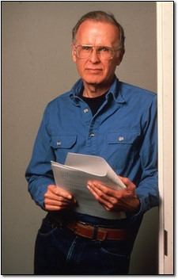
History - FORTRAN
The first FORTRAN (FORmula TRANslation) compiler was developed at IBM in 1957, by a team led by John Backus
Backus pioneered parsing techniques based on a formal set of syntax rules (a grammar)
FORTRAN was the first commercial compiler – it was an extra cost add-on when you bought an IBM computer
It is sometimes called the first modern compiler, because it employed formal grammar rules

Slide 15
History - COBOL
The first COBOL (Common Business Oriented Language) compiler was released in 1960.
COBOL was designed by an industry-wide committee – proposed by Mary Hawes, a Burroughs Corporation programmer
It was the first “standardized” programming language
It was heavily influenced by Grace Hopper, who advised the committee
It was the first language to run on multiple computers (the UNIVAC II and the RCA 501) – thus achieving the goal of portability
Notes:
Jean Sammet - Chairperson of the ACM’s Special Interest Committee on Symbolic and Algebraic Manipulation

Slide 16
New Challenges
Assemblers are easy to write.
No special techniques are needed
Anyone with a few years of programming experience should be able to write an assembler
The earliest assemblers were written using “brute force” programming
Compilers raised the bar
It is almost impossible to write a compiler using “brute force” methods
New programming concepts and techniques were needed – and that’s what we’ll be talking about this week and next

Slide 17
Assemblers versus Compilers
Assembler | Compiler
Scanline(): look for label, opcode, operands, comments | Scanner: also called a lexical analyzer or tokenizer. Breaks the input into a series of tokens
Processline(): indentify the opcode, process operands, etc. | Parser: a semantic analyzer, that recognizes the structure of the program based on the token stream, and builds an internal representation of the program
Second pass: Assemble the instructions and generate machine code into an object file | Code generator: process the internal representation and generate assembly-language code for a specific machine
Symbol Table: stores symbols and information about their type and definition | Symbol Table: stores symbols and information about their type and definition

Slide 18
Compiler Components
Source Code
(character stream)
Scanner
(lexical analyzer)
Tokens (types & values)
Parser (syntax analyzer)
Parse Tree (an internal representation of the program)
Assembly Language
Code Generator
Assembler
• • •
Notes:
Lexicon = vocabulary | Syntax = grammar | Semantics = meaning

Slide 19
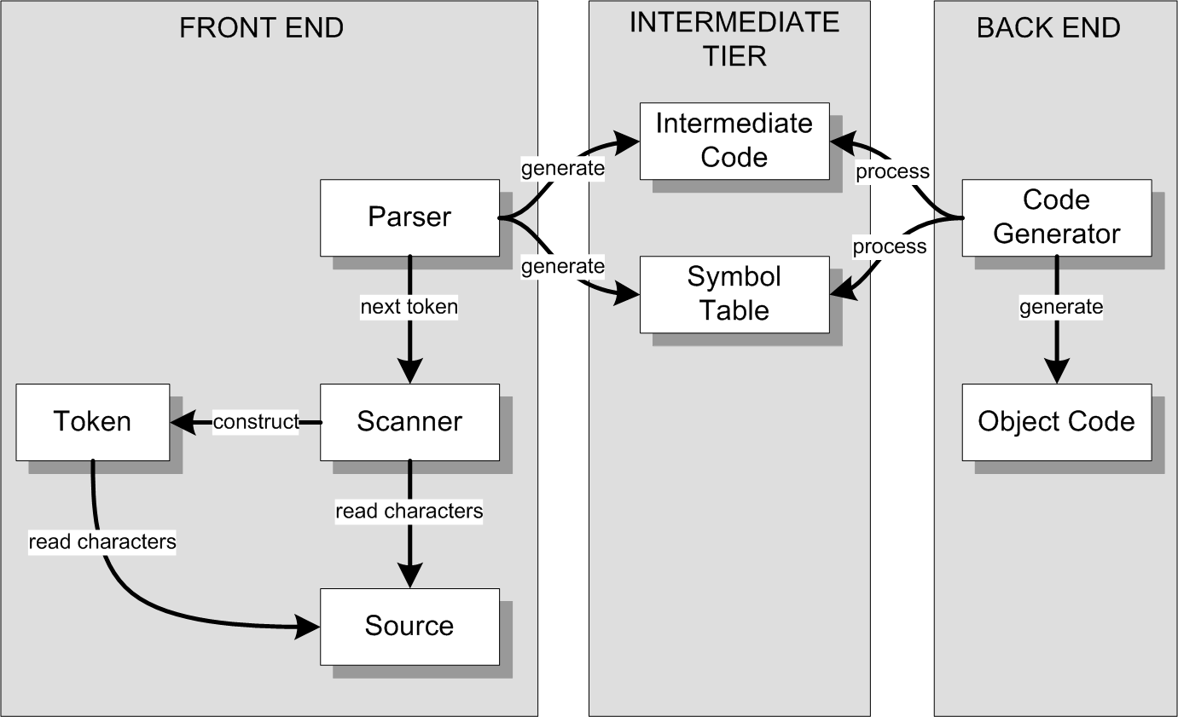
Conceptual Design
We can architect a compiler with three major parts:
Output a low-level, system dependent assembly language

Slide 20
Scanning
A scanner converts the input stream into a series of tokens, or lexical components that are part of the language: label keyword ( ) + / ; { }
Scanning typical uses a finite state machine or finite state automaton driven by an underlying state table.
The finite state machine is an efficient way to recognize a pre-defined lexicon of tokens in an input stream – and to report an error when a token cannot be recognized

Slide 21
Finite State Machines
Finite State Machine (FSM): an abstract machine that can be in exactly one of a finite number of states at any given time
The FSM can change from one state to another in response to inputs
The change from one state to another is called a transition
The FSM may define end states which represent the completion of a sequence of inputs
We often use diagrams to represent a finite state machine, because it’s easy to visualize and understand

Slide 22
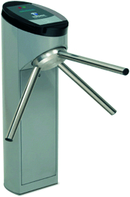
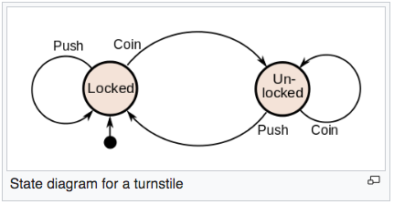
Turnstyle: a Real-Word FSM
Two States: locked and un-locked

Slide 23
A Simple FSM
Recognizes a valid sequence of inputs
Input Sequence | Result
abc | VALID: 4 is an end state
abcccabc | VALID: 4 is an end state
acc | INVALID: error in state 2
ab | INVALID: 3 is not an end state
1: start state (aka initial state)
4: end state (aka final state)

Slide 24
A Simple State Transition Table
STATE | a | b | c
1 | 2 | - | -
2 | - | 3 | -
3 | - | - | 4
(4) | 2 | - | 4
We can represent a state machine as a state transition table
Note the use of ( ) to indicate an end state
At the code level, we might use a negative number, or add a column to the table to flag end states

Slide 25
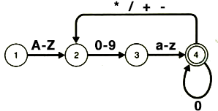
Additional “Transition” Notation
A-Z: any uppercase character
a-z: any lowercase character
0-9: any digit
A set of possible characters: * / + -

Slide 26
A More Complex (and useful) FSM
1
STATE | TYPE | A-Z | a-z | 0-9 | + - * /
1 |  | 2 | 2 | 3 | 4
(2) | Symbol | 2 | 2 | 2 | -
(3) | Integer | - | - | 3 | -
(4) | Operator | - | - | - | -
+ - * /
A-Z a-z
0-9
2
3
4
A-Z a-z
0-9
0-9
Note that we’ve added a token type to the State Transition Table

Slide 27
A Scanner / Lexical Analyzer / Tokenizer
Input = character stream Output = token stream
EXAMPLE: Inventory * 25 Symbol Operator Integer
EXAMPLE: Inventory - Sales Symbol Operator Symbol
EXAMPLE: - / Sales Inventory Operator Operator Symbol Symbol
1
+ - * /
A-Z a-z
0-9
2
3
4
A-Z a-z
0-9
0-9
Our FSM always considers ‘space’ characters to be a terminator, but NOT trigger a transition. This is a default rule for many languages.

Slide 28
The Scanner Is Called Repeatedly
space char
It is used to break the input stream into a sequence of tokens
In most languages, ‘space’ characters (including tab and end-of-line) can terminate a token, but are otherwise not part of the language lexicon
1
+ - * /
A-Z a-z
0-9
2
3
4
STATE | TYPE | space | A-Z | a-z | 0-9 | + - * /
1 |  | 1 | 2 | 2 | 3 | 4
(2) | Symbol | - | 2 | 2 | 2 | -
(3) | Integer | - | - | - | 3 | -
(4) | Operator | - | - | - | - | -
A-Z a-z
0-9
0-9

Slide 29
FSM Function
state = 1;
value = “”;
error = none;
while ((inchar = getnextchar()) != EOF) {
nextstate = STT_lookup(state, inchar);
if (nextstate == ‘-’) { // no valid transition
if (state is an endstate) {
unget(inchar); // for next token
}
else {
error = ”invalid token";
}
break;
}
state = nextstate;
value .= inchar; // appended inchar to value
}
if (error == none)
return type[state], value;
else
return error;
STATE | TYPE | space | A-Z | a-z | 0-9 | + - * /
1 |  | 1 | 2 | 2 | 3 | 4
(2) | Symbol | - | 2 | 2 | 2 | -
(3) | Integer | - | - | - | 3 | -
(4) | Operator | - | - | - | - | -
State Transition Table
Reminder: (n) indicates a valid end state

Slide 30
A Scanner is NOT a Syntax Analyzer
The scanner recognizes the language lexicon, or vocabulary
It will (happily) return sequences of tokens that are not valid syntax:
+ / Sales Inventory Operator Operator Symbol Symbol

Slide 31
Token Use: Parsing Versus Code Generation
In addition to the token type, the scanner returns the actual token values
Inventory - Sales Symbol (Inventory) Operator (-) Symbol (Sales)
In order to determine if a string of tokens represents a valid sequence, the parser needs to know the token types: Symbol Operator Symbol - VALID
In order to build code for execution, the code generator must have the specific values of the tokens: Inventory – Sales
In general, the syntax analyzer (parser) is concerned with token type, while the code generator is concerned with both token type and token value

Slide 32
Compiler Components
High Level Language Source Code (e.g. C++)
Scanner (lexical analyzer)
Tokens (types & values)
Parser (syntax analyzer)
Parse Tree (an internal representation of the program)
Assembly Language Source File
Code Generator
Interpreter
- OR -

Slide 33
Recognizing Syntax: Parsing
Languages are made up of a lexicon or vocabulary of tokens, which are combined using grammatical rules (syntax) to form meaningful statements
The parser recognizes the syntax, or grammatical structure of the token stream
The parser returns an internal representation of the program being compiled. The most common representation is a parse tree.
Scanner (lexical analyzer) | Parser (syntax analyzer)
Recognizes lexical elements in the input stream | Recognizes the grammatical structure of the program
Returns token types, and actual token values integer (356) | Returns an internal representation of the program typically a “parse tree”

Slide 34
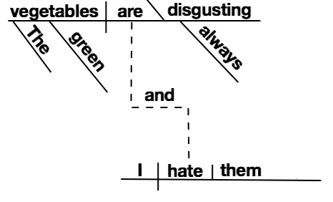
History: Describing a Grammar
The first formal grammar definition dates back to the 4th – 6th century BC
An Indian scholar named Pāṇini developed grammatical rules for Sanskrit
Even today, grammar is taught by “parsing” a sentence and breaking it down into a formal structure:
The green vegetables are always disgusting, and I hate them

Slide 35
History: Describing a Grammar
In 1959, John Backus (who led the FORTRAN team) had an insight: grammar rules were useful for things besides torturing students.
John Backus and Peter Naur created a notation for describing the grammar, or syntax, of a computer language
This notation is called BNF, which stands for Backus-Naur Form or Backus Normal Form
Many extensions and variants exist today, including Extended Backus–Naur form (EBNF) and Augmented Backus–Naur form (ABNF).

Slide 36
Backus Naur Form
Every rule in Backus-Naur form has the following structure: <name> ::= expansion
Every non-terminal symbol is enclosed by brackets
Symbols may be concatenated in the expansion, indicating a sequence: <expr> ::= <term> <operator> <expr>
Alternative expansions are separated by a vertical bar: | <expr> ::= <term> <operator> <expr> | <term>

Slide 37
BNF Example
<loop statement> ::= <while loop> | <for loop>
<while loop> ::= while “(“ <condition> “)“ <statement>
<for loop> ::= for “(“ <expression> “;” <expression> “;” <expression> “)“ <statement>
<assignment statement> ::= <variable> = <expression>
<digit> ::= “0” | “1” | “2” | “3” | “4” | “5” | “6” | “7” | “8” | “9”
<integer> ::= <digit> | <integer> <digit>
<letter> ::= <lowercase letter> | <uppercase letter>

Slide 38
Formal Grammars Eliminate Ambiguity
A = 2 + 3 * 5 Does A equal 25 or 17?
25: <expression> ::= <term> | <term> <operator> <expression> <term> ::= <variable> | <number> <operator> ::= “+” | “-” | “*” | “/”
17: <expression> ::= <term> | <term> <addoperator> <expression> | <term> <multoperator> <expression> <term> ::= <variable> | <number> <addoperator> ::= “+” | “-” <multoperator> ::= “+” | “/”

Slide 39
Using a Grammar
Once a grammar is defined:
it can be used as a guide for hand-coding a parser, or
It can be used by a variety of modern tools – such as YACC/Bison or ANTLR - that will automatically build the code for a parser
There are many “parser builders” – and each uses its own specification language for defining the grammar

Slide 40
Grammar “Formalism”
It is possible to create grammars that are not parseable
Grammars are categized based on certain characteristics, and specific algorithms have been created to parse each class of grammar
Parser builders are based on specific classes of grammars and their associated algorithms.
They will reject grammars that they cannot parse

Slide 41
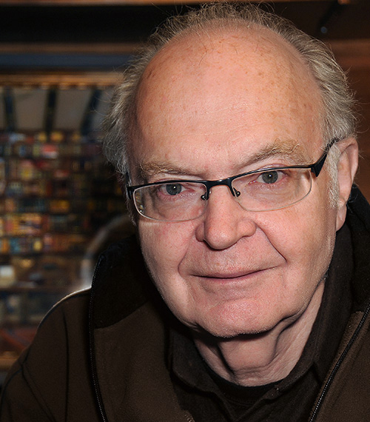
LR Grammars
In 1965, Donald Knuth – author of The Art of Computer Programming - invented the LR parser (Left to Right, Rightmost derivation). LR grammars and parsers are extremely memory intensive.
In 1969, Frank DeRemer proposed a simplified version of the LR parser, called the Look-Ahead LR (LALR) – the most widely used type of grammar today
Look-Ahead grammars rely on the ability to see the next token, without fetching it

Slide 42
LR versus LL
Both process tokens left to right
LL (left-to-right, leftmost derivation) grammars expand or derive the leftmost non-terminal first
Given a grammar tree, they attempt to expand the leftmost non-terminal first
LR (left-to-right, rightmost derivation) grammars expand or derive the rightmost non-terminal first
Given a grammar tree, they attempt to expand the rightmost non-terminal first
The grammar type affects the specific languages that can be parsed (and hence the design of programming languages), and the amount of processing power and memory required to parse them

Slide 43
Parser Generators
In the early 70s, Stephen Johnson at Bell Labs created the YACC (Yet Another Compiler Compiler) parser generator, and the LEX lexical analyzer, drawing heavily on Knuth’s algorithms.
Bison, a YACC replacement, is included in most POSIX distributions.
Currently popular parser generators include JavaCC (Java Compiler Compiler) and ANTLR (Another Tool for Language Recognition)
ANTLR is able to process LL(0) and LL(1) (Left-to-right, Leftmost derivation) grammars, where the number represents the degree of look-ahead required
The classes of grammars are beyond the scope of this course, and won’t appear on assignments or exams.

Slide 44
Example: A Simple Program in “SICTRAN”
PRINT("Fibonacci Sequence \n\n\n");
i = 0;
prev_prev = -1;
prev = 1;
WHILE (i <= 30)
{
fib = prev_prev + prev;
PRINT(i); PRINT(": "); PRINT(fib);
IF (fib%5 == 0)
PRINT(" Divisible by 5!");
PRINT(“\n”);
i = i + 1;
prev_prev = prev;
prev = fib;
}

Slide 45
Output of Simple Program
Fibonacci Sequence
0: 0 Divisible by 5!
1: 1
2: 1
3: 2
4: 3
5: 5 Divisible by 5!
6: 8
7: 13
8: 21
9: 34
10: 55 Divisible by 5!
11: 89
12: 144
13: 233
14: 377
15: 610 Divisible by 5!
16: 987
17: 1597
18: 2584
19: 4181
20: 6765 Divisible by 5!
21: 10946
22: 17711
23: 28657
24: 46368
25: 75025 Divisible by 5!
26: 121393
27: 196418
28: 317811
29: 514229
30: 832040 Divisible by 5!

Slide 46
Grammar for SICTRAN – Using ANTLR
program : stmtList ;
stmtList : stmt ( ';' stmt )* ;
stmt : assignmentStmt
| ifStmt
| whileStmt
| printStmt
| compoundStmt
;
Char (s) | Meaning
: | Separates rule name from expansion
; | End of a rule
| | Or
( … )* | Repeat contents 0 or more times
( … )+ | Repeat contents 1 or more times
‘c’ | Input character c – returned by scanner
NAME | Uppercase NAME indicates a token type that is returned by the scanner
# string | Comment
The complete grammar is in the download files in Canvas

Slide 47
Grammar of SICTRAN - continued
assignmentStmt : variable '=' intExpr ;
ifStmt : IF '(' boolExpr ')' stmt ;
whileStmt : WHILE '(' boolExpr ')' stmt ;
compoundStmt : '{' stmtList '}' ;
printStmt : PRINT '(' printArg ')' ;
printArg : variable # printVar
| STRING # printStr ;
variable : IDENTIFIER ;
intExpr : intExpr mulDivOp intExpr
| intExpr addSubOp intExpr
| number
| signedNumber
| variable
| '(' intExpr ')'
;
Full Antler grammar for SICTRAN is 39 rules

Slide 48
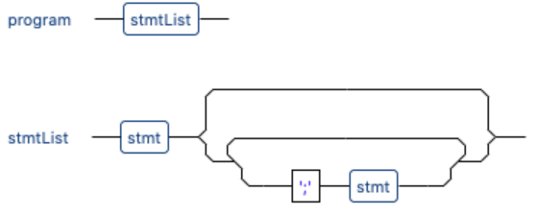
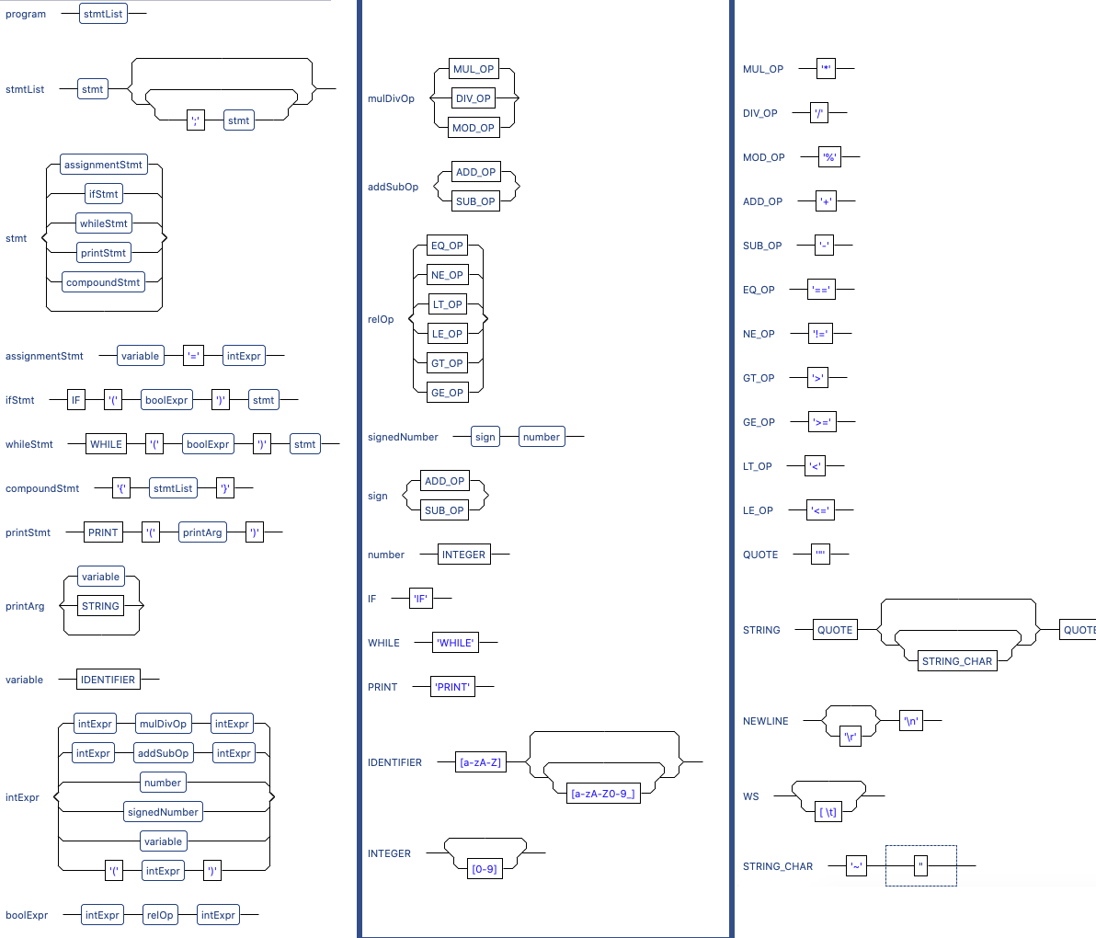
Grammar Diagram for SICTRAN
Useful visual aide, generated by parser builder
Full Antler grammar diagram is in the download files in Canvas

Slide 49
Using the Grammar: Writing a Parser
Grammar Tree: Consider all of the rules in a grammar arranged into a tree structure
Parsers may walk the tree bottom up or top down, with variants of each, based on the grammar class and the parser algorithm
Bottom Up: start with the token in the bottom (or leaf) rule, and attempt to walk upwards in the tree by matching the input token stream against the tree.

Slide 50
Using the Grammar: Writing a Parser
Top down: start with the top-most rule ( program: stmtList ; ) and recursively walk down the tree looking for matches in the token stream.
Reminder: The process in which a function calls itself directly or indirectly is called recursion and the corresponding function is called a recursive function
We will learn how to write a top-down, recursive-descent parser to build a parse tree, which can then be passed to the code generator

Slide 51
What Does the Parser Do?
The parser is the heart of the compiler
Given a set of grammar rules, it analyzes the token stream and converts it to a data structure that can be used to generate code… typically a parse tree
It calls on a scanner, or lexical analyzer, which accepts characters from the input stream and returns tokens to the parser.

Slide 52
Compiler Components - reminder
High Level Language Source Code (e.g. C++)
Scanner (lexical analyzer)
Tokens (types & values)
Parser (syntax analyzer)
Parse Tree (an internal representation of the program)
Assembly Language Source File
Code Generator
Interpreter
- OR -

Slide 53
Aside: Data Structures and Algorithms
As we get deeper into compilers, we will talk about a number of data structures, such as stacks, tables, arrays, trees, linked lists, and so on.
There are well established coding techniques to create, manipulate, and traverse these structures. There are formal courses and books that explore them:
CMPE 126: Algorithms and Data Structure Design
CMPE 180A: Data Structures and Algorithms in C++
Don Knuth’s Art of Computer Programming, volumes 1-3
The pioneers in computing had to invent everything from the ground up, but modern software developers can draw on decades of knowledge

Slide 54
Building a Parser by Hand
A top-down, recursive-descent parser can be coded entirely by hand, simply by writing a function for each rule.
The “rule” functions may call functions for other rules
Rule functions accept parse trees returned by the lower level functions they call, and combine those trees… returning the resulting tree to the caller.
Let’s look at some concrete examples…

Slide 55
Top-Down, Recursive Descent Parser
program : stmtList ;
function parse_program {
if ((tree = parse_stmtList()) == error)
return error;
return tree;
}

Slide 56
Top-Down, Recursive Descent Parser
stmtList : stmt ( ';' stmt )* ;
function parse_stmtList {
if ((tree = parse_stmt()) == error)
return error;
while (parse_SEMICOLON() != error) {
if ((subtree = parse_stmt()) != error)
attach subtree to tree;
else {
ungetToken(); // the ability to “unget” a token is called a look-ahead rule
break;
}
}
return tree;
}

Slide 57
Top-Down, Recursive Descent Parser
SEMICOLON : ‘;’ ;
function parse_SEMICOLON {
nextToken = getNextToken(); // call to scanner
if (nextToken.type == SEMICOLON)
return nextToken;
else {
ungetToken(); // the ability to “unget” a token is called a look-ahead rule
return error;
}
}

Slide 58
The Parse Tree – the Output of the Parser
Sample Parse Tree (based on the example on the previous few slides)
program
stmtList
stmt
stmt
stmt
stmt
stmt

Slide 59
The Parse Tree – Additional Examples
Inventory - Sales
Expression
Variable
Operator
Variable
Inventory
-
Sales

Slide 60
The Parse Tree – Additional Examples
Inventory = Inventory - Sales
Assignment
Variable
Expression
Inventory
Variable
Operator
Variable
Inventory
-
Sales

Slide 61
Hand Coding Versus Parser Builders
It is certainly possible to write a parser entirely by hand, by writing a function for each rule in the grammar
A typical term project in compiler classes
SICTRAN – a very simple, PASCAL-like language, has 39 rules
Grammars for modern real-world programming languages may have many thousands of rules
Parser builders make it feasible to create parsers for large, complex languages
They are also useful for simple languages, to avoid the minutia of parser programming

Slide 62
Code Generation (hand waving)
To generate code, we “walk” the tree and take appropriate action for each statement type
2
Assignment
1
LDA Inventory
SUB Sales
STA Inventory
Variable
1
Expression
2
Inventory
Variable
Operator
Variable
Inventory
-
Sales

Slide 63
Walking the Parse Tree
In the previous example, why did we visit and process the tree nodes in a rather strange order?
That’s the responsibility of the functions written for the code generator
The code generator, like the parser, will have a separate function for each node type.
The code in that function will determine how – and in what order - it processes child nodes

Slide 64
Fibonacci - A Simple Program in “SICTRAN”
PRINT("Fibonacci Sequence \n\n\n");
i = 0;
prev_prev = -1;
prev = 1;
WHILE (i <= 30)
{
fib = prev_prev + prev;
PRINT(i); PRINT(": "); PRINT(fib);
IF (fib%5 == 0)
PRINT(" Divisible by 5!");
PRINT(“\n”);
i = i + 1;
prev_prev = prev;
prev = fib;
}

Slide 65
Fibonacci Output
Fibonacci Sequence
0: 0 Divisible by 5!
1: 1
2: 1
3: 2
4: 3
5: 5 Divisible by 5!
6: 8
7: 13
8: 21
9: 34
. . .

Slide 66
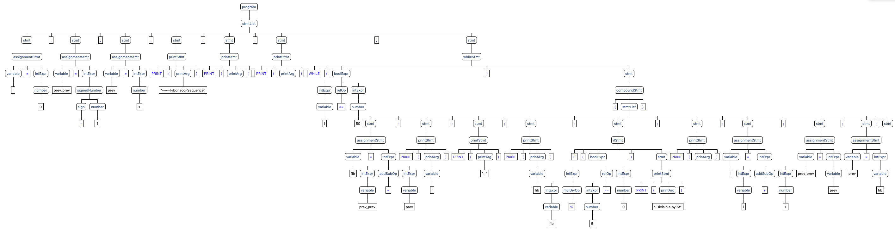
Fibonacci Parse Tree – a 14 line program!
The complete parse tree is in the download files in Canvas

